Slide 1

Database Processing: Fundamentals, Design, and Implementation
15th Edition
Week #2
Part 1A
Introduction to Structured Query Language

Slide 2
Structured Query Language
Structured Query Language (SQL) was developed by the IBM Corporation in the late 1970’s.
SQL was endorsed as a U.S. national standard by the American National Standards Institute (ANSI) in 1992 [SQL-92].
Newer versions exist, such as SQL:2008, SQL:2011, and SQL:2016 and they incorporate new features including XML, JSON, and some object-oriented concepts. Some of these features are discussed in this book.

Slide 3
SQL As a Data Sublanguage
SQL is not a full-featured programming language.
C, C#
SQL is a data sublanguage for creating and processing database data and metadata.
SQL is ubiquitous in enterprise-class DBMS products.
SQL programming is a critical skill.

Slide 4
SQL Categories
SQL statements can be divided into five categories:
Data definition language (DDL)
Data manipulation language (DML) statements
SQL/Persistent Stored Modules (SQL/PSM) statements
Transaction control language (TCL) statements
Data control language (DCL) statements

Slide 5
SQL DDL
Data definition language (DDL) statements
Used for creating tables, relationships, and other structures

Slide 6
SQL DML
Data manipulation language (DML) statements
Used for:
Queries – SQL SELECT statement
Inserting data – SQL INSERT statement
Modifying data – SQL UPDATE statement
Deleting data – SQL DELETE statement

Slide 7
SQL SQL/PSM
SQL/Persistent Stored Modules (SQL/PSM) statements
Add procedural programming capabilities
Variables
Control-of-flow statements

Slide 8
SQL TCL and DCL
Transaction control language (TCL) statements
Used to mark transaction boundaries and control transaction behavior
Data control language (DCL) statements
Used to grant (or revoke) database permissions to (from) users and groups

Slide 9
Data Tables Used in Examples (1 of 2)
Table
RETAIL_ORDER
ORDER_ITEM
Column | Data Type
OrderNumber | Integer
StoreNumber | Integer
StoreZIP | Character (9)
OrderMonth | Character (12)
OrderYear | Integer
OrderTotal | Currency
OrderNumber | Integer
SKU | Integer
Quantity | Integer
Price | Currency
ExtendedPrice | Currency

Slide 10
Data Tables Used in Examples (2 of 2)
Table
SKU_DATA
BUYER
CATALOG_SKU_20##
Column | Data Type
SKU | Integer
SKU_Description | Character (35)
Department | Character (30)
Buyer | Character (35)
BuyerName | Character (35)
Department | Character (30)
Position | Character (10)
Supervisor | Character (35)
CatalogID | Integer
SKU | Integer
SKU_Description | Character (35)
Department | Character (30)
CatalogPage | Integer
DateOnWebSite | Date

Slide 11
The SQL SELECT Statement
The fundamental framework for an SQL query is the SQL SELECT statement.
SELECT {ColumnName(s)}
FROM {TableName(s)}
WHERE {Condition(s)}
All SQL statements end with a semicolon(;).

Slide 12
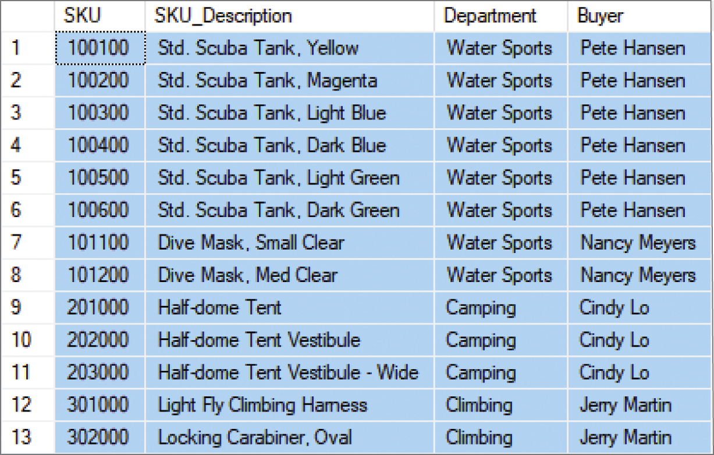
Specific Columns from a Single Table
SELECT SKU, SKU_Description, Department, Buyer
FROM SKU_DATA;

Slide 13

Selecting All Columns: The SQL Asterisk (*) Wildcard Character
SELECT *
FROM SKU_DATA;

Slide 14
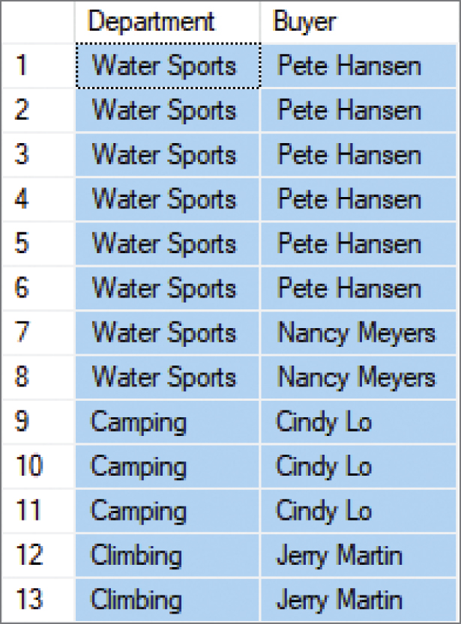
Specifying Column Order I
SELECT Department, Buyer
FROM SKU_DATA;

Slide 15
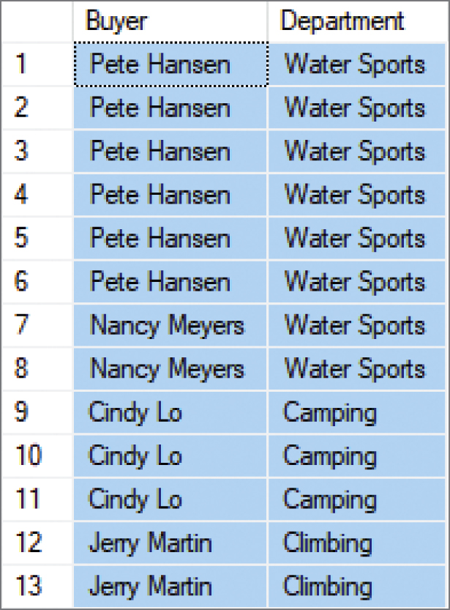
Specifying Column Order II
SELECT Buyer, Department
FROM SKU_DATA;

Slide 16
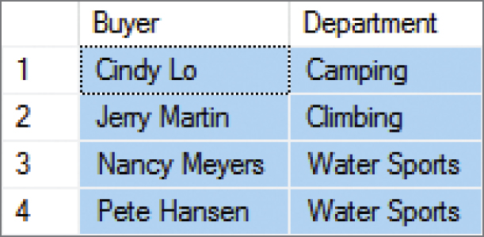
Reading Specified Rows from a Single Table The SQL DISTINCT Keyword
SELECT DISTINCT Buyer, Department
FROM SKU_DATA;

Slide 17
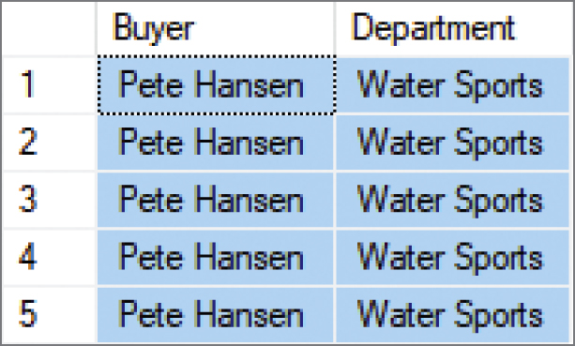
Controlling the Number of Rows from a Single Table I The SQL TOP {NumberOfRows} Function
SELECT TOP 5 Buyer, Department
FROM SKU_DATA;

Slide 18
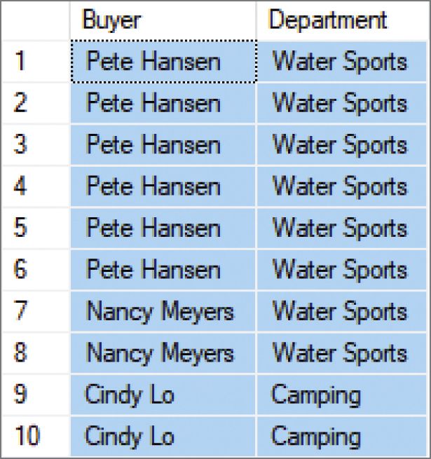
Controlling the Number of Rows from a Single Table II The SQL TOP {Percentage} PERCENT Function
SELECT TOP 75 PERCENT Buyer, Department
FROM SKU_DATA;

Slide 19
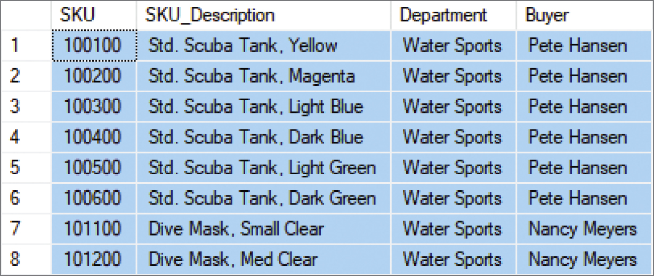
Controlling Specified Rows from a Single Table The SQL WHERE Clause: Character Strings
SELECT *
FROM SKU_DATA
WHERE Department = 'Water Sports';

Slide 20
SQL Comparison Operators
SQL Comparison Operators
Operator | Meaning
= | Is equal to
<> | Is NOT Equal to
< | Is less than
> | Is greater than
<= | Is less than OR equal to
>= | Is greater than OR equal to
IN | Is equal to one of a set of values
NOT IN | Is NOT equal to one of a set of values
BETWEEN | Is within a range of numbers (includes the end points)
NOT BETWEEN | Is NOT within a range of numbers (includes the end points)
LIKE | Matches a sequence of characters
NOT LIKE | Does NOT match a sequence of characters
IS NULL | Is equal to NULL
IS NOT NULL | Is NOT equal to NULL

Slide 21
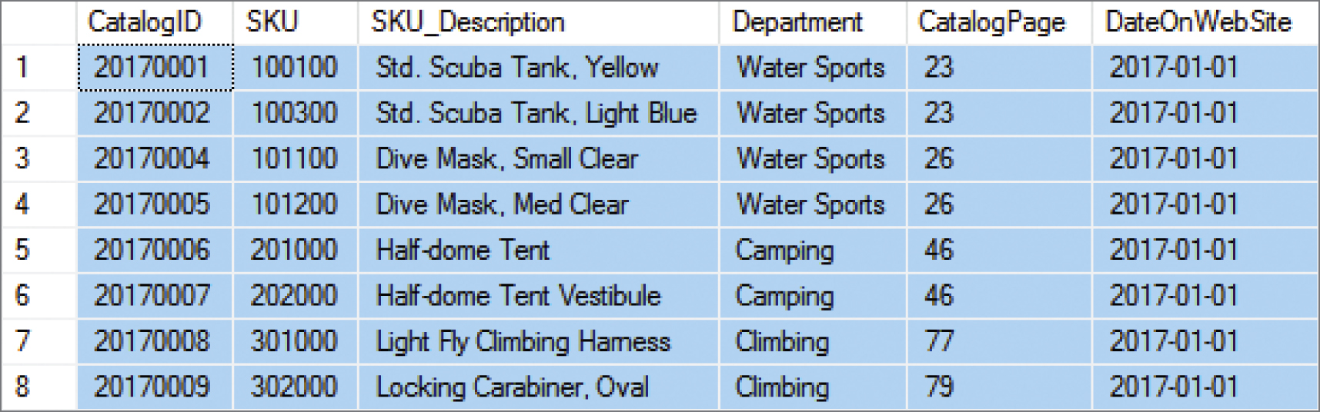
Reading Specified Rows from a Single Table I The SQL WHERE Clause: Dates
SELECT *
FROM CATALOG_SKU_2017
WHERE DateOnWebSite = '01-JAN-2017';

Slide 22
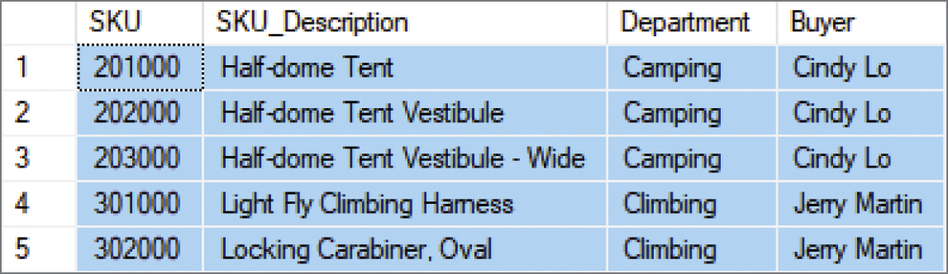
Reading Specified Rows from a Single Table II The SQL WHERE Clause: Numbers
SELECT *
FROM SKU_DATA
WHERE SKU > 200000;

Slide 23
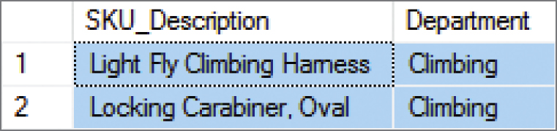
Reading Specified Columns and Rows from a Single Table I Column Names and the SQL WHERE Clause
SELECT SKU_Description, Department
FROM SKU_DATA
WHERE Department = 'Climbing';

Slide 24
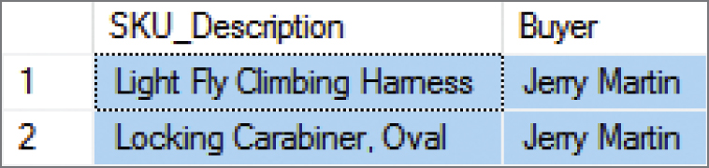
Reading Specified Columns and Rows from a Single Table II Column Names and the SQL WHERE Clause
SELECT SKU_Description, Buyer
FROM SKU_DATA
WHERE Department = 'Climbing’;
SQL does not require that the column used in the WHERE clause also appear in the SELECT clause column list as seen above.

Slide 25
Database Processing Fundamentals, Design, and Implementation (15th Edition)
End of Presentation:
Week #2
Part 1A

